Slide 1

National Forensic Sciences University
An Institution of National Importance
(Ministry of Home Affairs, Government of India)
School of Management Studies - MBA in Business Intelligence
Semester 4
MAJOR PROJECT
On
Transaction Fraud Detection
Guide:
Prof. VIPUL JOSHI
Name of Student Enrollment Number
VASU 101MTMBBI2122024
2021-23

Slide 2

CONTENT
Introduction
About Company
Internship Profile
Problem Statement
Work Performed
Block Diagram
ML Model
Literature survey
E-Learnings
Mitigation Measures
Future work
References

Slide 3

INTRODUCTION
In this Major project, we will focus on Transaction Fraud Detection using ML models and Pump and Dump system. Transaction fraud refers to any unauthorized use of a legitimate user's payment information for making purchases, without their knowledge or consent. This type of fraud is quite broad and can include a wide range of activities. Typically, with credit cards, transaction fraud involves the unauthorized use of a victim's credit card to make purchases. This practice is illegal based on securities law and can lead to heavy fines. The burgeoning popularity of cryptocurrencies has resulted in the proliferation of pump-and-dump schemes within the industry
Recent News About Fraud- Adani Fraud - In the month of Feb Gautam Adani, India’s top billionaire, had a good start to the year when he announced a follow-on public offer to raise INR 20,000 cr from the Indian stock market. Troubles started mounting soon after a New York-based investment research firm by the name of Hindenburg Research published a report accusing Adani of potential fraud. The scathing report alleged that the Adani Group indulged in accounting fraud and manipulation of stocks, a claim that has brought Adani down to his knees from the throne of the third richest in the world to slip off the ranking of even the top 20 as of today.
Silicon Valley Bankruptcy - On March 10, 2023, Silicon Valley Bank (SVB) failed after a bank run, marking the second-largest bank failure in United States history and the largest since the 2007–2008 financial crisis. It was one of three March 2023 United States bank failures. Seeking higher investment returns, in 2021 SVB began shifting its marketable securities portfolio from short-term to long-term Treasury bonds. The market value of these bonds decreased significantly through 2022 and into 2023 as the Federal Reserve raised interest rates to curb an inflation surge, causing unrealized losses on the portfolio

Slide 4
ABOUT COMPANY
PredictRam is a recognized FinTech Startup by DPIIT (Govt of India) and a proud member of the FICCI Startup programme, they are the providers and developers of Collective-Intelligence platform for predicting Economic & financial markets events using blockchain, predictive analysis, big data and machine learning technologies.
By sourcing estimates from a diverse community of individuals, We provide data that is more accurate, and a more representative view of expectations compared to sell-side-only data sets that suffer from demonstrable biases. PredictRAM aims to give the market a transparent data set of true expectations while providing analysts with a platform to build a verifiable track record.
PredictRam Providers and developers of open financial results & economic events collective intelligence predictive analysis platforms where hedge fund, independent, and sell-side analysts, along with investors, industry experts and students contribute their opinions and forecast estimates for companies & events.
Their diverse network consists of Financial analysts, equity analysts, financial domain students, analysts, and data science students, data analysts, CA, CFA, and FRM students across the globe.

Slide 5
INTERNSHIP PROFILE
Financial Research Analyst- To read up on upcoming financial and economic events.
(events can be any upcoming economic or financial events an avenue to upload opinions by selecting top performance stocks by doing in-depth analysis and estimates that support a financial and economic event)
Analyze the results by looking up previous information
Data Preprocessing Process and creating a financial model for forecasting support
And model training and evaluation (Create reports then submit them on the dashboard provided, And data visualization.)

Slide 6

Problem statement
Pump-and-dump is a manipulative scheme that attempts to boost the price of a stock or security through fake recommendations. These recommendations are based on false, misleading, or greatly exaggerated statements. The perpetrators of a pump-and-dump scheme already have an established position in the company's stock and will sell their parts after the hype has led to a higher share price.
In this Project We will Focus on the pump and dump system (2.0 and 3.0) we will observe the financial model working and mechanism and possible mitigation measures to avoid these practices
Pump-and-Dump 2.0
The same scheme can be perpetrated by anyone with access to an online trading account and the ability to convince other investors to buy a stock that is supposedly "ready to take off.“
Pump-and-Dump 3.0
The cryptocurrency market has become the newest arena for pump-and-dump schemes. The massive gains made by Bitcoin and Ethereum have kindled tremendous interest in cryptocurrencies of every stripe

Slide 7
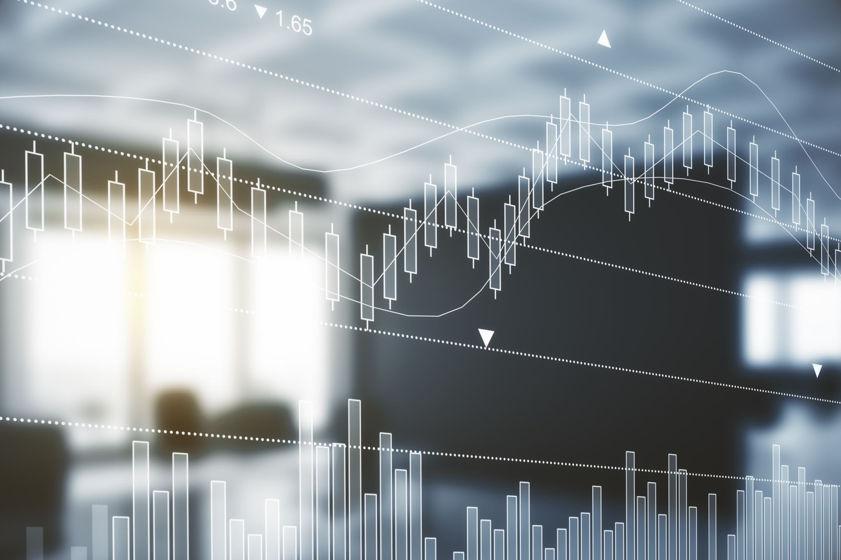
Work performed
Prepared various reports and learned about financial industry applications to ML models and predictive analysis, forecasting using previous data by the company.
I have covered many economic events some of which are international (USA Initial Jobless Claim, USA CPI Inflation Rate YoY Dec 2022, USA Manufacturing Purchasing Managers Index, USA Gross Domestic Product Q4 GDP QoQ 2023 etc), and some are national (Budget analysis 2023, India CPI, WPI index report and India FX reserve.).
Prepared and reported new economic events like WPI and CPI index inflation for June 2023. and learned financial concepts about pump and dump systems, ML, AI, and recent advancements in the field.

Slide 8
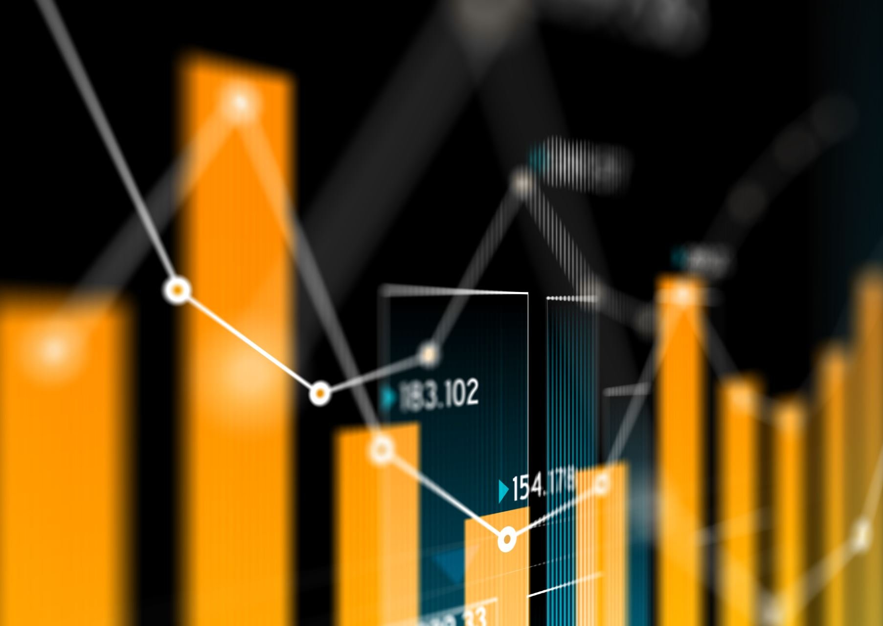
Internship profile
Financial event published
Research conducted
ML model creations
Data input and Forecasting
Output Portfolio submitted and reviewed by authorities and ratings are given for report submission.
Actual Report by Govt compared to our report

Slide 9

Financial Model
Exploratory Data Analysis
EDA is an approach to analyzing the data using visual techniques. It is used to discover trends, and patterns, or to check assumptions with the help of statistical summaries and graphical representations.
While performing the EDA of the Tesla Stock Price data we analyze how prices of the stock have moved over the period of time.

Slide 10
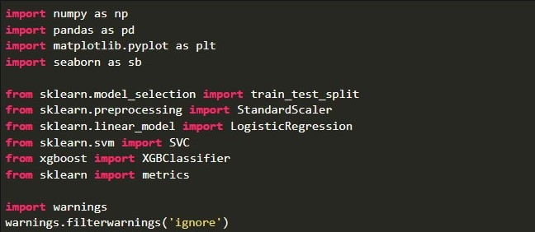
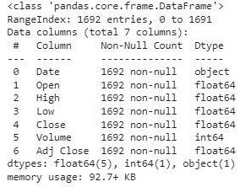
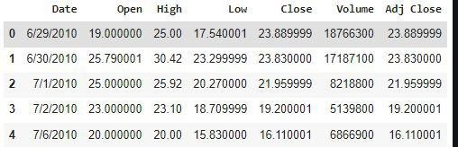


Slide 11
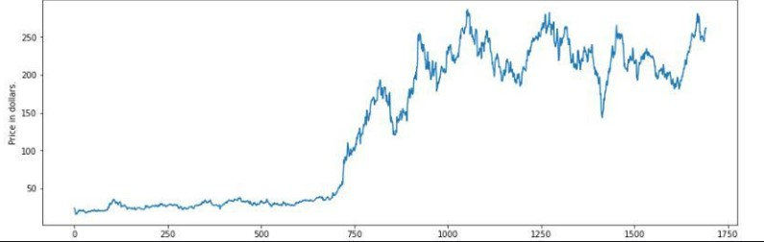
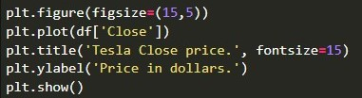
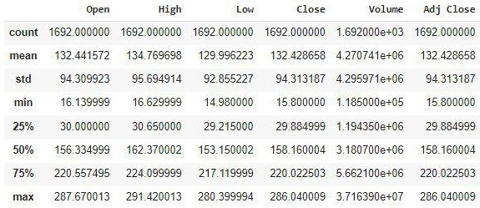

Slide 12
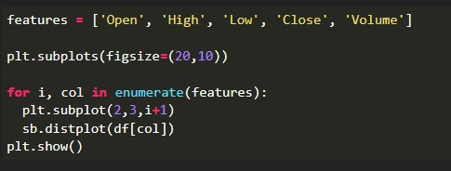
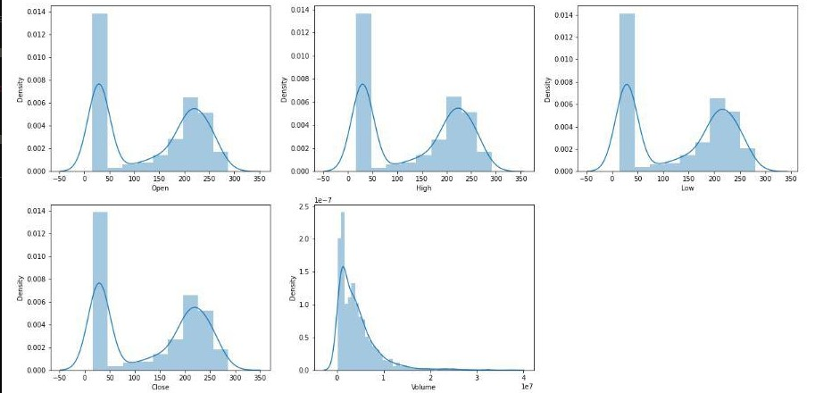

Slide 13
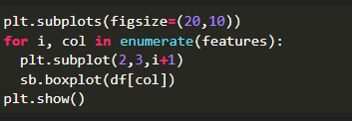
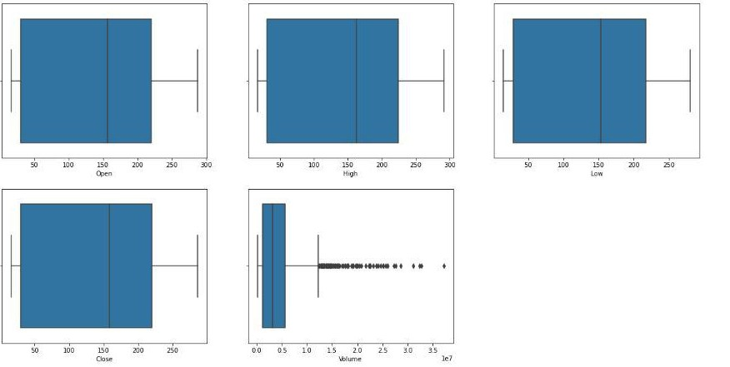

Slide 14
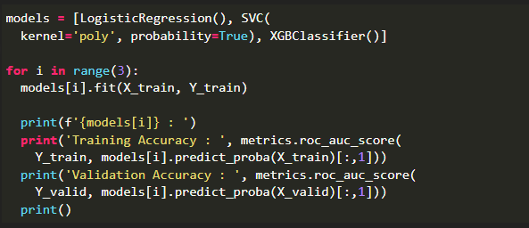
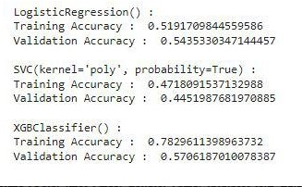
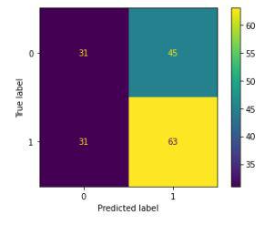


Slide 15
Literature survey
Sr no. | Paper title and its author | Details of publication | Findings/ outcome
1 | Detecting “Pump & Dump Schemes” on Cryptocurrency Market Using An Improved Apriori Algorithm Author: Weili Chen∗†, YueJin Xu∗†, Zibin Zheng∗†, Yuren Zhou∗, Jianxun Eileen Yang‡ and Jing Bian | Publisher: IEEE International Conference on Service-Oriented System Engineering (SOSE) (978-1-7281-1442-2/19/$31.00 ©2019 IEEE DOI 10.1109/SOSE.2019.00050) Publishing Year: 2019 | In this paper, they propose an improved Apriori algorithm to detect user groups who may involve in “pump & dump” schemes. By using the leaked transaction history of the famous Bitcoin exchange Mt. Gox, we found many user groups which buy or sell at the same time. To further analyse the detected groups, we found many abnormal trading records, i.e., abnormal trading behaviours and trading prices.
2 | Pump-and-Dump Manipulation in Cryptocurrency Markets Author: Anirudh Dhawan and Talis J. Putnin¸ | Publisher: - Indian Institute of Management Bangalore, India, 2University of Technology Sydney, Australia, Stockholm School of Economics in Riga, Latvia and 4Digital Finance Co-operative Research Centre, Australia Publishing Year: : 4 August 2022 | Cryptocurrencies have given rise to a new form of pump-and-dump manipulation, which is similar in some respects to traditional pump-and-dump manipulation of stocks but completely different in other respects widespread manipulation can damage the perceived integrity of cryptocurrency markets and investor confidence in tokens and tokenization.

Slide 16
Sr no. | Paper title and its author | Details of publication | Findings/ outcome
3 | Detecting cryptocurrency pump-and-dump frauds using market and social signals Author: Huy Nghiem *, Goran Muric , Fred Morstatter , Emilio Ferrara | Publisher:University of Southern California, Information Sciences Institute, 4676 Admiralty Way, Marina del Ray, Los Angeles, California, USA Publishing Year: 2021 | In this paper, they propose an approach to predict the target cryptocurrency for each pump before its announcement using market and social media signals using Neural Network-based architectures while offering interpretable insights into their black-box nature. Additionally, the construct models that are capable of forecasting the highest price induced by the pump after the cryptocurrency’s identity is revealed within 6.1% error margin. (CLSTM models BLSTM models CNN models )
4 | Explainable AI-Driven Financial Transaction Fraud Detection using Machine Learning and Deep Neural Networks Author: Chaithanya Vamshi Saia , Debashish Dasa, *, Nouh Elmitwallya , Ogerta Elezaja Md Baharul Islamb | Department of Computing & Data Science, Faculty of Computing, Engineering & the Built Environment, Birmingham City University, United Kingdom bCollege of Data Science and Engineering, American University of Malta, Malta * Corresponding Author Publishing Year: : 18 May 2023 | This research tackled and filled the gap of the lack of explainability by implementing an Explainable AI (XAI)-driven Interface for Financial Transaction Fraud Detection using Machine Learning (ML) & Deep Neural Networks (DNN) The research contributed to both Explainable AI (XAI) research community and practical business value to solve fraud detection business problems in the financial services and banking industry by implementing five cutting-edge Explainable AI (XAI) methods for enhancing the model interpretability.

Slide 17
Sr no. | Paper title and its author | Details of publication | Findings/Outcome
5 | (Case Study-1) Title: A Comparative Analysis - Credit card fraud detection using Machine Learning Techniques. Author: John O. Awoyemi, Adebayo O. Adetunmbi, Samuel A. Oluwadare | Department of Computer Science Federal University of Technology Akure Akure, Nigeria Publishing Year: 2017 | The performance of fraud detection in credit card transactions is greatly affected by the sampling approach on dataset, selection of variables and detection technique(s) used. This paper investigates the performance of naïve bayes, k-nearest neighbor and logistic regression on highly skewed credit card fraud data. The results shows of optimal accuracy for naïve bayes, k-nearest neighbor and logistic regression classifiers are 97.92%, 97.69% and 54.86% respectively.
6 | (Case study 2) Title: Fraud Detection using Machine Learning and Deep Learning Author: Pradheepan Raghavan, Neamat El GayarSchool of Mathematical and Computer Sciences Heriot Watt University Dubai, UAE | 2019 International Conference on Computational Intelligence and Knowledge Economy (ICCIKE) Publishing Year: December 11-12-2019 | This paper aims to benchmark multiple machine learning methods such as k-nearest neighbour (KNN), random forest and support vector machines (SVM), while the deep learning methods such as autoencoders, convolutional neural networks (CNN), restricted Boltzmann machine (RBM) and deep belief networks (DBN).

Slide 18
Sr. No. | Paper Title and its Author | Details of Publication | Findings/Outcome
7 | (Case study 3) Title: The advanced proprietary AI/ML solution as Anti-fraud- Tensorlink4cheque (AFTL4C) for Cheque fraud detection. PRABHAKARA R UYYALA, Dr. DYAN CHANDRA YADAV | CSE DEPARTMENT, JS UNIVERSITY Publishing Year: 2023 | The AFTL4C solution was developed to detect cheque fraud in real-time using a Generative Adversarial Network (GAN) approach to compare various factors on scanned cheque images. The solution assigns a confidence point to each object of the scanned cheque image

Slide 19
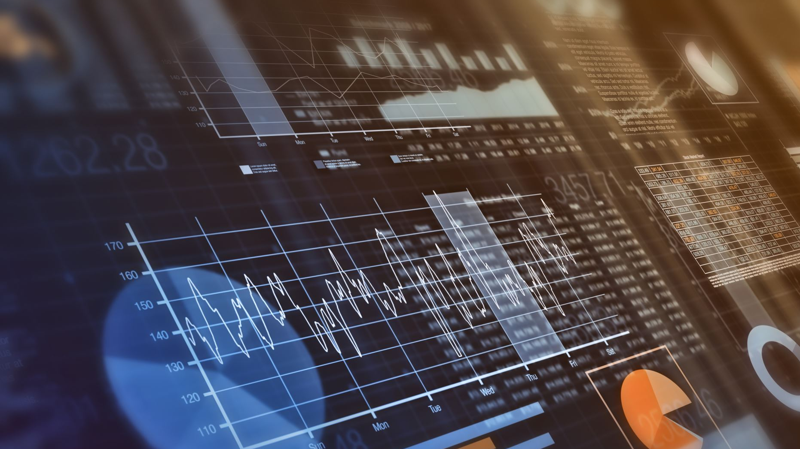
E- Learnings
Learning are as follows-
How-to pick-up stocks and how we can perform analysis on the data provided. And how we can build a stock portfolio AND How to read the stock graphs. AND Learning Financial Industry concepts like (WPI, CPI, FX reserves, and Dump and Pump concepts). AND
ML model creations by Python and in-depth analysis performed.
ML model Libraries used Pandas – helps to load the data frame in a 2D array format and has multiple functions to perform analysis tasks in one go.
Numpy – Numpy arrays are very fast and can perform large computations in a very short time.
Matplotlib/Seaborn – This library is used to draw visualizations.
Sklearn – This module contains multiple libraries having pre-implemented functions to perform tasks from data preprocessing to model development and evaluation.
XGBoost – This contains the eXtreme Gradient Boosting machine learning algorithm which is one of the algorithms which helps us to achieve high accuracy on predictions.
Financial Forecasting- Financial forecasting is the process of estimating or predicting how a business or project will perform financially in the future. Financial forecasting is a crucial element of financial planning as it estimates important financial metrics such as sales, income, and future revenue, which are necessary for finance-related operations such as budgeting and capital budgeting. A financial forecast is an estimate of future financial outcomes for a company or project, usually applied in budgeting, capital budgeting, and/or valuation. The most common type of financial forecast is an income statement; however, a complete financial model should include forecasts for all three financial statements: income statement, balance sheet, and cash flow statement.
Predictive analysis- a subset of advanced analytics that utilizes historical data, statistical modelling, data mining techniques, and machine learning to make predictions about future events or outcomes. It involves analyzing current and past data to identify patterns and trends, which are then used to build models that can predict future behaviors or events. Predictive analytics is widely used in business applications to identify opportunities and mitigate risks. Some common applications of predictive analytics include fraud detection, customer segmentation, and demand forecasting.

Slide 20

Learning are as follows-
Recent advancement - The Anti-fraud-Tensorlink4cheque (AFTL4C) is a new AI/ML-based solution developed to detect cheque fraud in real time. Cheque fraud has become a major issue for financial institutions, resulting in millions of losses due to fraudulent activities. The AFTL4C solution uses Generative Adversarial Network (GAN) technique to compare various factors on scanned cheque images to identify potential counterfeits in real time.
Artificial intelligence (AI) is used in FinTech to create solutions specifically tailored to the problems that traditional finance and banking sectors, like Fraud Detection, Risk Management, Investment Management, Predictive Analytics, and Anti-Money Laundering. The banking sector is profiting more from AI technology within the financial services industry. Banks have made better business decisions by adopting AI to automate investment operations, improve customer relationship management, detect fraud more accurately, and cut operational expenses through Robotic Process Automation (RPA).

Slide 21

Mitigation Measures
Identify the warning signs
Does the offer sound too good to be true?
Is the seller using high-pressure sales tactics?
Was the investment offer unsolicited?
Did the seller ask for information that is usually considered personal (e.g. social security number, credit card information, etc.) over the phone or Internet?
If you answer “yes” to any of the above questions when considering an investment opportunity, you may be the target of a scam artist.
Take action to avoid fraud
Don’t believe everything you are told by the seller. Take the time to do your own research on the investment’s potential.
Don’t assume the solicitor is who he or she claims to be.
Check with federal and state securities regulators to find out if there have been any complaints against the company.
Ask the promoter whether—and how much—he or she has been paid to tout the opportunity.
Ask where the company is incorporated and then call that state to ensure that the company has a current annual report on file.
Request written financial information, such as a prospectus, annual report, offering circular, or financial statements, then compare the written information to what you were told.
Get offers in writing and save a copy for your records.
Check with a trusted financial advisor, your broker, or an attorney about any investments you are considering.
Report scams when they occur
File a complaint with the Securities and Exchange Commission, state securities regulator, or a law enforcement agency.
Report the crime promptly—you’ll have a better chance of getting your money back if you do.

Slide 22
Future work
More Research on fraud detection and prevention and How we can Associate AI with it. And Dump and Pump system 3.0
Application of ML and security purposes.
As this project was the application of the internship with PredictRam more focus will be on Financial Model Further improvement, algorithm improvements, Article studies and Blogs and Case studies.
Through this project I want to make awareness about the Pump and Dump system in the stock market as we have already seen current examples like (SV Bank Failed, and various other bank failures)

Slide 23
References
Detecting “Pump & Dump Schemes” on Cryptocurrency Market Using An Improved AprioriAlgorithm Weili Chen∗†, YueJin Xu∗†, Zibin Zheng∗†, Yuren Zhou∗, Jianxun Eileen Yang‡ and Jing Bian∗ School of Data and Computer Science, Sun Yat-sen University, Guangzhou, China National Engineering Research Center of Digital Life, Sun Yatsen University, 510006, Guangzhou, China corresponding author. Shenzhen
Sai, Chaithanya Vamshi, et al. "Explainable Ai-Driven Financial Transaction Fraud Detection Using Machine Learning and Deep Neural Networks." Available at SSRN 4439980.
A NewWolf in Town? Pump-and-Dump Manipulation in Cryptocurrency Markets* Anirudh Dhawan1,2 and Talis J. Putnin¸s2,3,4 1Indian Institute of Management Bangalore, India, 2University of Technology Sydney, Australia, 3Stockholm School of Economics in Riga, Latvia and 4Digital Finance Co-operative Research Centre, Australia (Review of Finance, 2023, 935–975 https://doi.org/10.1093/rof/rfac051 Publication Date: 4 August 2022)
Detecting cryptocurrency pump-and-dump frauds using market and social signalsHuy Nghiem *, Goran Muric , Fred Morstatter , Emilio Ferrara University of Southern California, Information Sciences Institute, 4676 Admiralty Way, Marina del Ray, Los Angeles, California, USA (journal homepage: www.elsevier.com/locate/eswa) https://doi.org/10.1016/j.eswa.2021.115284 Received 18 November 2020; Received in revised form 17 May 2021; Accepted 23 May 2021.
The economics of stock touting during Internet based pump and dump campaigns Michael Siering Goethe University Frankfurt, Theodor‐W.‐Adorno‐Platz 4, 60323 Frankfurt, Germany (Info Systems J. 2018;1–28. wileyonlinelibrary.com/journal/isj) © 2018 John Wiley & Sons Ltd (DOI: 10.1111/isj.12216)
Explainable AI-Driven Financial Transaction Fraud Detection using Machine Learning and Deep Neural Networks Chaithanya Vamshi Saia , Debashish Dasa, *, Nouh Elmitwallya , Ogerta Elezaja , Md Baharul Islamb (https://ssrn.com/abstract=4439980 )
A Comparative Analysis Credit card fraud detection using Machine Learning Techniques: Samuel A. Oluwadare, Adebayo O., Adetunmbi, John O. Awoyemi (978-1-5090-4642-3/17/$31.00 ©2017 IEEE)
Deep Learning Detecting Fraud in Credit Card Transactions Abhimanyu Roy, Jingyi Sun, Robert Mahoney, Loreto Alonzi, Stephen Adams, Peter Beling 978-1-5386-6343-1/18/$31.00 ©2018 IEEE

Slide 24
Fraud Detection using Machine Learning and Deep Learning Pradheepan Raghavan, Neamat El GayarSchool of Mathematical and Computer Sciences Heriot Watt University Dubai, UAE2019 International Conference on Computational Intelligence and Knowledge Economy (ICCIKE 978-1-7281-3778-0/19/$31.00 ©2019 IEEE)
Predictive-Analysis-based Machine Learning Model for Fraud Detection with Boosting Classifiers M. Valavan and S. Rita* Department of Statistics, Periyar University, Salem, Tamilnadu, India (Computer Systems Science & Engineering DOI: 10.32604/csse.2023.026508)
The advanced proprietary AI/ML solution as Anti-fraud- Tensorlink4cheque (AFTL4C) for Cheque fraud detection. Dr. DYAN CHANDRA YADAV, PRABHAKAR R UYYALA COMPUTER AND SCIENCE ENGINEERING Research Scholar, JS UNIVERSITY, The International journal of analytical and experimental modal analysis Volume XV, Issue IV, April/2023 ISSN NO: 0886-9367
Web References-
1 https://www.forbes.com/advisor/in/investing/why-adani-shares-are-falling/
2 https://seon.io/resources/transaction-fraud-detection/
3 https://www.cnbc.com/2023/03/24/svb-collapse-squad-app-ceo-says-silicon-valley-bank-failure-was-agony.html
4 https://www.investopedia.com/terms/p/pumpanddump.asp
5 Abu-Mostafa, Y.S., Atiya, A.F. Introduction to financial forecasting. Appl Intell 6, 205–213 (1996). https://doi.org/10.1007/BF00126626
6 PREDICTIVE ANALYTICS Extending the Value of Your Data Warehousing Investment (Book) By Wayne W. Eckerson

Slide 25
THANK YOU

